Slide 1
Built-in Collections
by Rostyslav Synenko
Notes:
In javascript there are collections that has numeric indices and these called indexed collections, collection that has associative indices and these called keyed collections that have a key of any type.

Slide 2
Indexed collections Array Iterators Typed Array

Slide 3
Array object An array is an ordered set of values that you refer to with a name and an index. JavaScript does not have an explicit array data type.
Notes:
However, you can use the predefined Array object and its methods to work with arrays in your applications. The Array object has methods for manipulating arrays in various ways, such as joining, reversing, and sorting them. It has a property for determining the array length and other properties for use with regular expressions.

Slide 4

Creating an array
Notes:
element0, element1, ..., elementN is a list of values for the array's elements. When these values are specified, the array is initialized with them as the array's elements. The array's length property is set to the number of arguments.
The bracket syntax is called an "array literal" or "array initializer." It's shorter than other forms of array creation, and so is generally preferred.

Slide 5
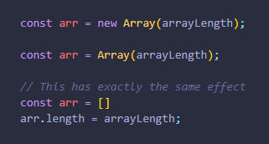
Create an array with non-zero length, but without any items
Notes:
arrayLength must be a Number. Otherwise, an array with a single element (the provided value) will be created. Calling arr.length will return arrayLength, but the array actually contains empty (undefined) elements.

Slide 6
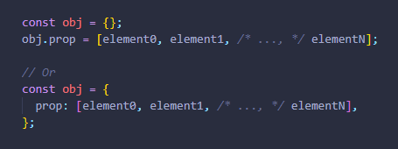
Arrays can also be assigned as a property of a new or an existing object.

Slide 7
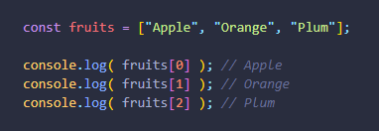
Array elements are numbered, starting with zero. We can get an element by its number in square brackets:

Slide 8
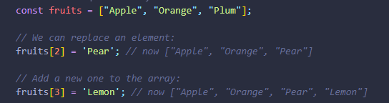

.

Slide 9
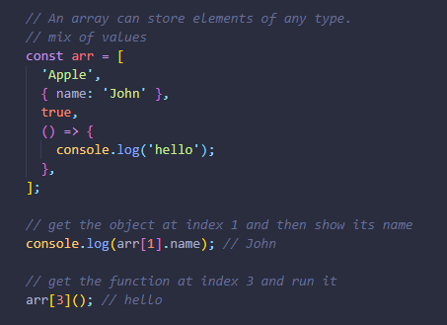
.

Slide 10
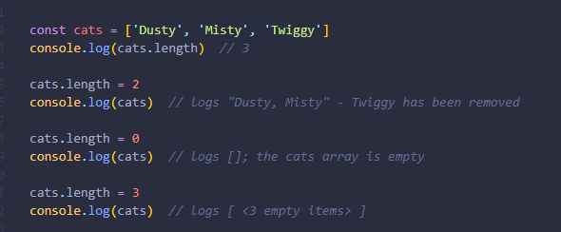
Understanding length
Notes:
At the implementation level, JavaScript's arrays actually store their elements as standard object properties, using the array index as the property name.
The length property is special. It always returns the index of the last element plus one.
Remember, JavaScript Array indexes are 0-based: they start at 0, not 1. This means that the length property will be one more than the highest index stored in the array
You can also assign to the length property.
Writing a value that is shorter than the number of stored items truncates the array. Writing 0 empties it entirely:

Slide 11
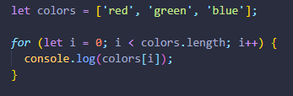
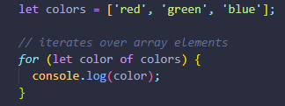
Iterating over arrays One of the oldest ways to cycle array items is the for loop over indexes: But for arrays there is another form of loop, for..of:
Notes:
A common operation is to iterate over the values of an array, processing each one in some way.

Slide 12
Array methods Add/remove elements push(...items) – adds items to the end, pop() – extracts an item from the end, shift() – extracts an item from the beginning, unshift(...items) – adds items to the beginning. splice(pos, deleteCount, ...items) – at index pos delete deleteCount elements and insert items (modify the array itself) slice(start, end) – creates a new array, copies elements from position start till end (not inclusive) into it. concat(...items) – returns a new array: copies all members of the current one and adds items to it. If any of items is an array, then its elements are taken

Slide 13
Search among elements indexOf/lastIndexOf(item, pos) – look for item starting from position pos, return the index or -1 if not found. includes(value) – returns true if the array has value, otherwise false. find/filter(func) – filter elements through the function, return first/all values that make it return true. findIndex is like find, but returns the index instead of a value.

Slide 14
Iterate over elements forEach(func) – calls func for every element, does not return anything.
Notes:
The arr.forEach method allows to run a function for every element of the array.

Slide 15
Transform the array map(func) – creates a new array from results of calling func for every element. sort(func) – sorts the array in-place, then returns it (modify the array itself) reverse() – reverses the array in-place, then returns it (modify the array itself) split/join – convert a string to array and back. reduce(func, initial) – calculate a single value over the array by calling func for each element and passing an intermediate result between the calls.

Slide 16
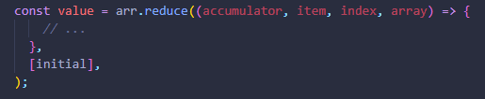
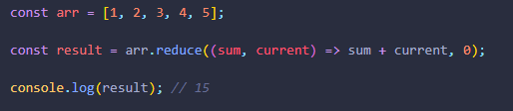
reduce/reduceRight Are used to calculate a single value based on the array.
Notes:
The function is applied to all array elements one after another and “carries on” its result to the next call.
Arguments:
accumulator – is the result of the previous function call, equals initial the first time (if initial is provided).
item – is the current array item.
index – is its position.
array – is the array.
As function is applied, the result of the previous function call is passed to the next one as the first argument.
So, the first argument is essentially the accumulator that stores the combined result of all previous executions. And at the end it becomes the result of reduce.

Slide 17
Additionally: Array.isArray(arr) checks arr for being an array. It returns true if the value is an array, and false otherwise.

Slide 18
These methods are the most used ones, they cover 99% of use cases. But there are few others: arr.some(fn)/arr.every(fn) checks the array. The function fn is called on each element of the array similar to map. If any/all results are true, returns true, otherwise false. arr.fill(value, start, end) – fills the array with repeating value from index start to end. arr.copyWithin(target, start, end) – copies its elements from position start till position end into itself, at position target (overwrites existing).

Slide 19
Iterator Iterators are a new way to loop over any collection in JavaScript. They were introduced in ES6. Іterator is an object which defines a sequence and potentially a return value upon its termination.

Slide 20
Specifically, an iterator is any object which implements the Iterator protocol by having a next() method returns an object with two properties: value The next value in the iteration sequence. done This is true if the last value in the sequence has already been consumed. If value is present alongside done, it is the iterator's return value.

Slide 21
The most common iterator in Javascript is the Array iterator, which simply returns each value in the associated array in sequence.

Slide 22
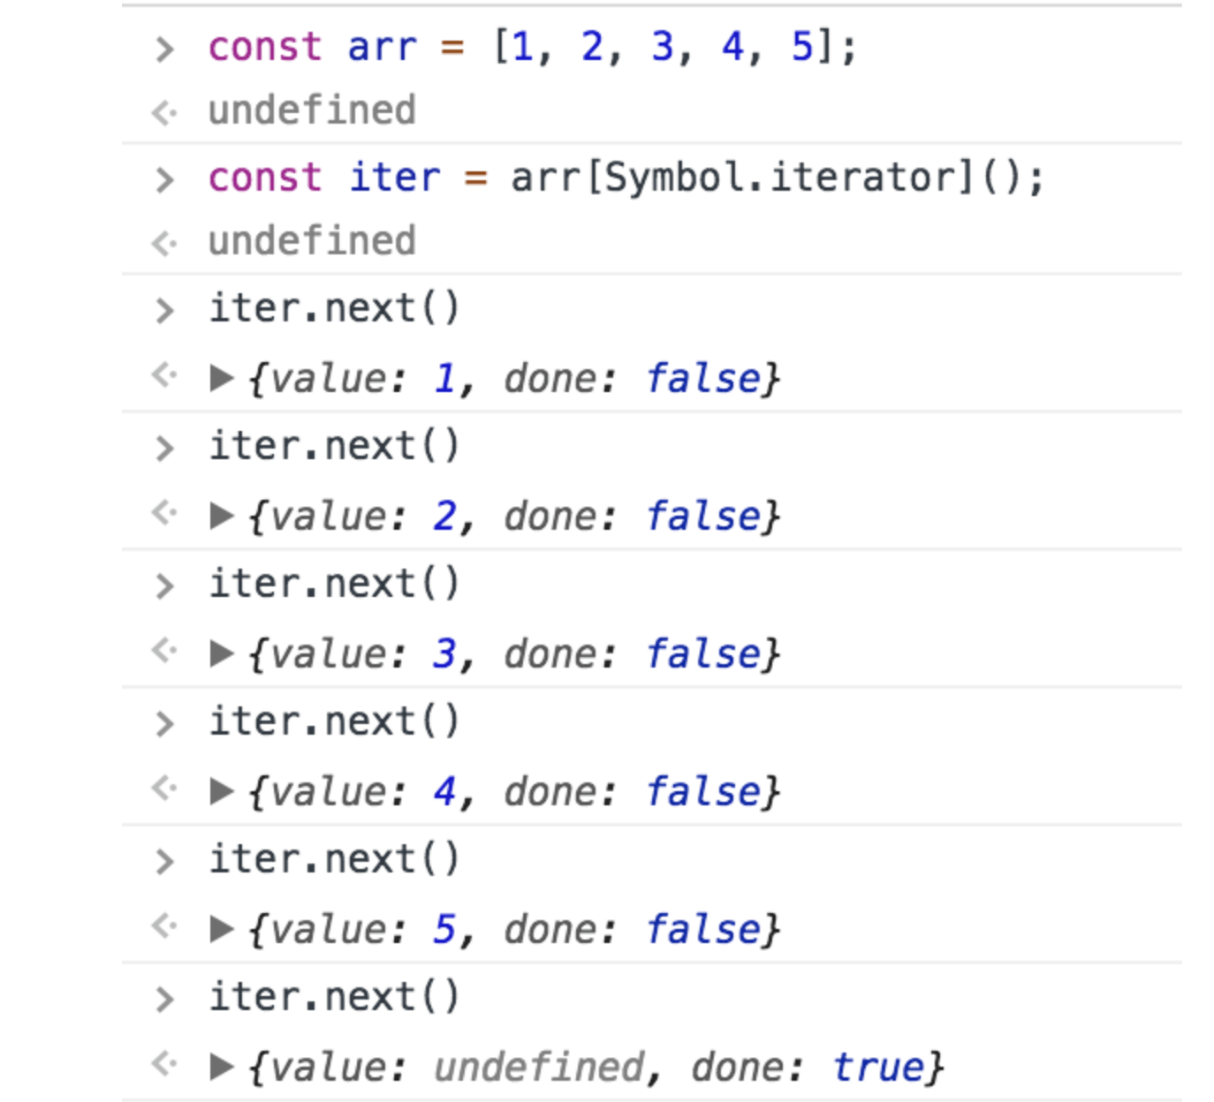
.
Notes:
Note: Array already have symbol.iterator key as a function in them and in above example Symbol.iterator represents the property of iter object which when we call, construct an iterator instance for consuming that object’s values through next.

Slide 23
Iterators are consumed only as necessary. Because of this, iterators can express sequences of unlimited size, such as the range of integers between 0 and Infinity.

Slide 24
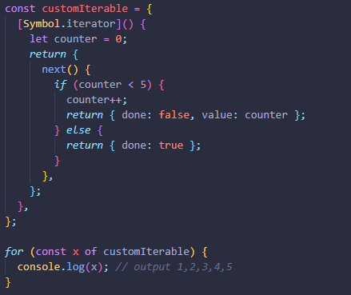
Custom iterators object example

Slide 25
Typed Array Array-like objects that provide a mechanism for reading and writing raw binary data in memory buffers. Each entry in a JavaScript typed array is a raw binary value in one of a number of supported formats, from 8-bit integers to 64-bit floating-point numbers.
Notes:
There is no global property named TypedArray, nor is there a directly visible TypedArray constructor. Instead, there are a number of different global properties, whose values are typed array constructors for specific element types

Slide 26
Buffers and views: typed array architecture A buffer (implemented by the ArrayBuffer object) is an object representing a chunk of data; it has no format to speak of, and offers no mechanism for accessing its contents. In order to access the memory contained in a buffer, you need to use a view. A view provides a context — that is, a data type, starting offset, and number of elements — that turns the data into an actual typed array.
Notes:
Щоб досягти максимальної гнучкості та ефективності typed array розділили на буфери та представлення.
Буфер (реалізований об'єктом ArrayBuffer) - це об'єкт, що представляє собою фрагмент даних; він не має формату, про який можна говорити, і не пропонує механізму доступу до його вмісту. Для доступу до пам'яті, що міститься в буфері, вам потрібно скористатися view(представлення). View забезпечує контекст - тобто тип даних, початкове зміщення та кількість елементів - який перетворює дані у typed array.

Slide 27
ArrayBuffer is a data type that is used to represent a generic, fixed-length binary data buffer. You can't directly manipulate the contents of an ArrayBuffer; instead, you create a typed array view or a DataView which represents the buffer in a specific format, and use that to read and write the contents of the buffer.
Notes:
Об'єкт ArrayBuffer використовується для роботи з бінарними даними. Він являє собою посилання на потік "сирих" бінарних даних, проте працювати з ними безпосередньо можливості не дає. Замість цього, ви можете створити typed array або об'єкт DataView, який представляє буфер в конкрентому форматі і використовувати для читання і запису даних буферу.

Slide 28
Typed array views Typed array views have self descriptive names and provide views for all the usual numeric types like Int8, Uint32, Float64 and so forth. There is one special typed array view, the Uint8ClampedArray. It clamps the values between 0 and 255. This is useful for Canvas data processing, for example.
Notes:
Typed arrays мають описові назви та надають представлення для всіх звичайних числових типів, таких як Int8, Uint32, Float64 тощо. Існує один спеціальний вид набраного масиву - Uint8ClampedArray. Він має значення між 0 і 255. Це корисно, наприклад, для обробки даних Canvas

Slide 29
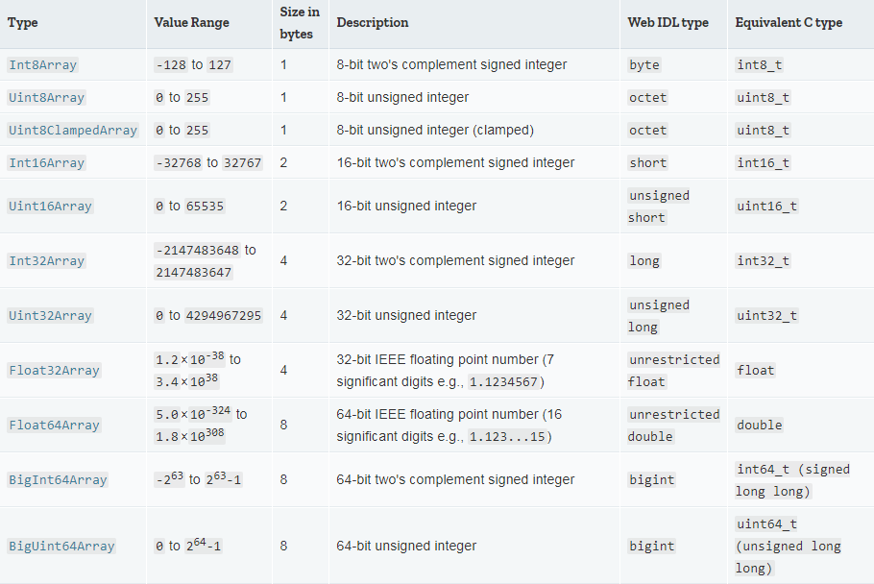

Slide 30
Keyed collections Map Set WeakMap WeakSet

Slide 31
Map The Map object holds key-value pairs and remembers the original insertion order of the keys. Any value (both objects and primitive values) may be used as either a key or a value.

Slide 32
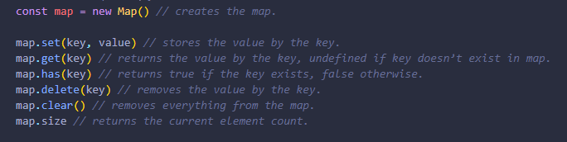
Methods and properties

Slide 33
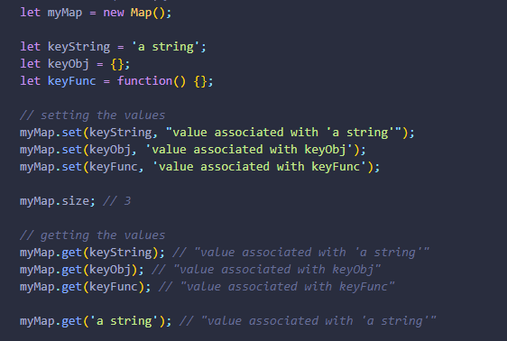
Example

Slide 34
Iteration over Map For looping over a map, there are 3 methods: keys() – returns an iterable for keys, values() – returns an iterable for values, entries() – returns an iterable for entries [key, value], it’s used by default in for..of.

Slide 35
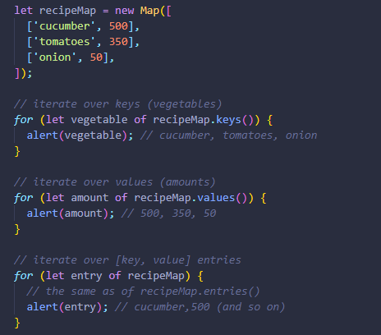
Example

Slide 36
Set The Set object lets you store unique values of any type, whether primitive values or object references.

Slide 37
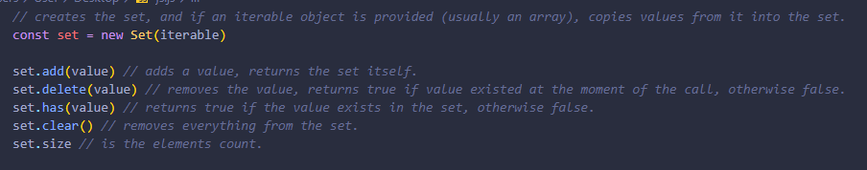
Example

Slide 38
WeakMap and WeakSet WeakMap is Map-like collection that allows only objects as keys and removes them together with associated value once they become inaccessible by other means. WeakSet is Set-like collection that stores only objects and removes them once they become inaccessible by other means. Both of them do not support methods and properties that refer to all keys or their count. Only individual operations are allowed.

Slide 39
WeakMap and WeakSet are used as “secondary” data structures in addition to the “main” object storage. Once the object is removed from the main storage, if it is only found as the key of WeakMap or in a WeakSet, it will be cleaned up automatically.

Slide 40
Links 1. https://developer.mozilla.org/en-US/docs/Web/JavaScript/Guide/Indexed_collections 2. https://developer.mozilla.org/en-US/docs/Web/JavaScript/Guide/Keyed_collections 3. 4. 5.

